Slide 1

EEG Signal Classification Using Transfer Learning
Mohammad Mahdi Mirrashid
Supervisor: Dr. Mohammad Bagher Shamsollahi
EE Department - Sharif University of Technology
Spring 2023

Slide 2
Table of Contents
01
Introduction
02
Project
03
Limitations and Future Directions

Slide 3
01
Introduction
EEG
Transfer Learning

Slide 4
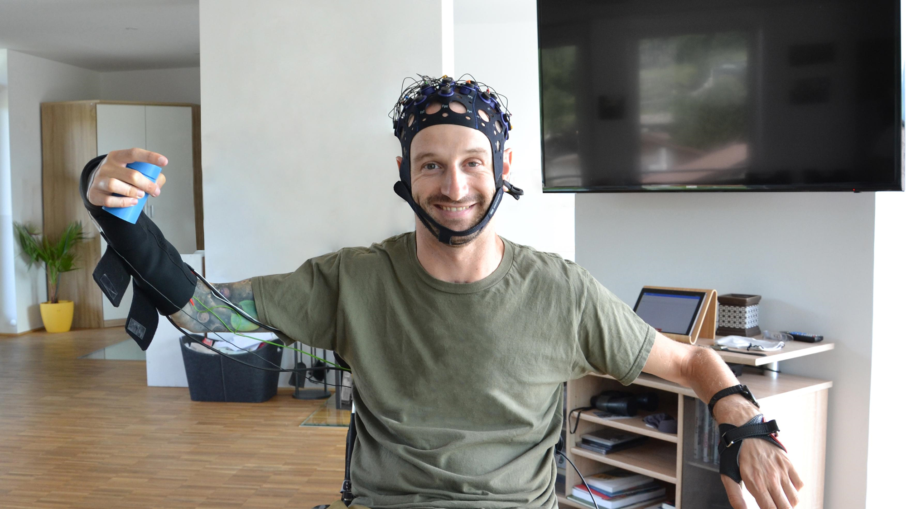
Introduction: EEG
Electroencephalography
Applications
Rehabilitation
Emotion recognition
Research
Challenges
Variability
Noise

Slide 5
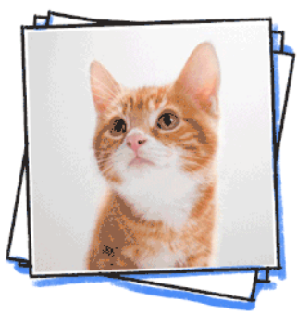

Introduction: Transfer Learning
Model 1
Model 1
Knowledge
Source
Model 2
Model 2
Target
Classic Machine Learning
Transfer Learning

Slide 6
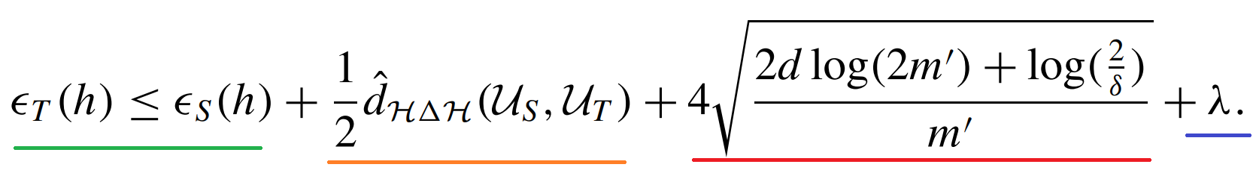
Introduction: Transfer Learning
(2010) The following holds with probability 1 - 𝛿
Target and source error
Domain dissimilarity
Number of samples (and the probability stuff)
Combined error

Slide 7
02
Project
Data
Methodology
Data Alignment
Augmentation
Final Results

Slide 8
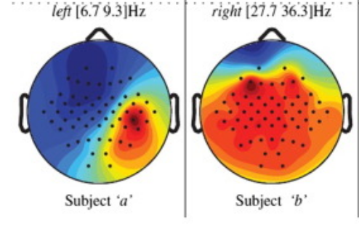
Project: Data
9 Subjects
22 Electrodes
Imagination of left or right hand
Bandpass filtered
144 trials with a duration of 3 seconds

Slide 9
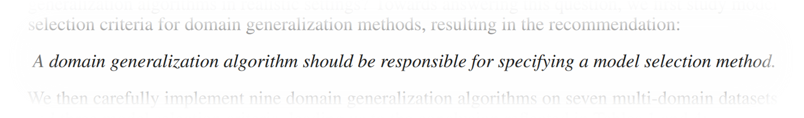
Project: Methodology
Labeled data of 8 subjects, unlabeled data of the remaining
Average accuracy calculated on 9 subjects
In Search of Lost Domain Generalization (2020)
Leave-one-subject-out cross-validation for hyperparameter selection

Slide 10
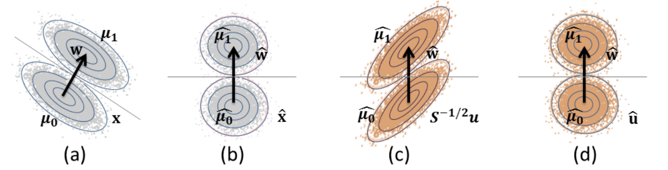
Project: Data Alignment
Correlation Alignment (CORAL), 2016
Idea: align the second moments of data distribution
Extension: Higher-order moments matching (2019)
EEG equivalent: Euclidean alignment (2018)
EA
Feature
Extraction

Slide 11
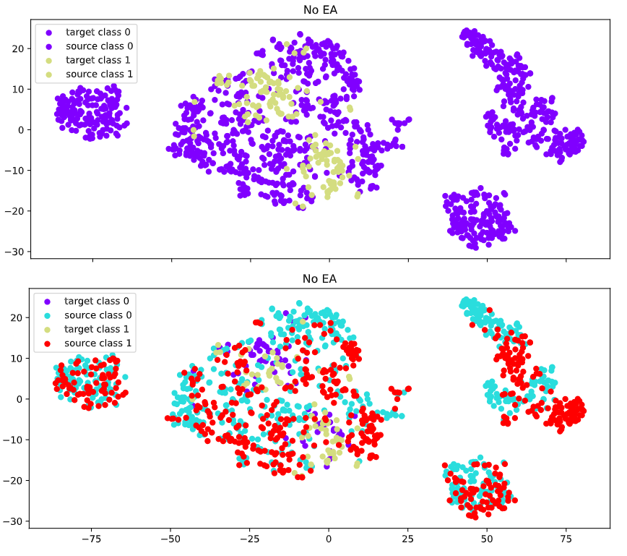
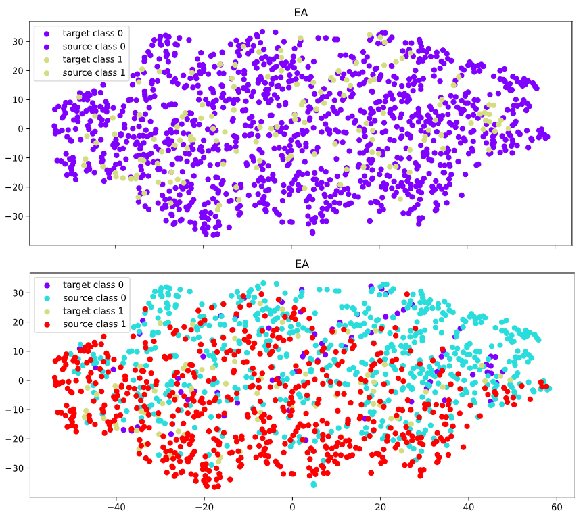
Project: Data Alignment

Slide 12
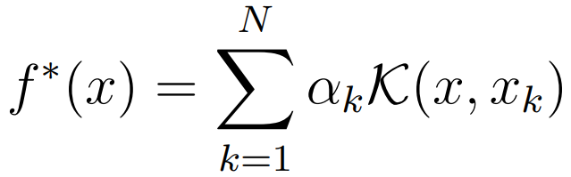
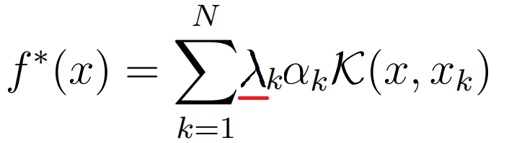
Project: Augmentation
Representer theorem (2001):
Idea: multiply the kernel by a shrinkage factor for samples of different domains

Slide 13
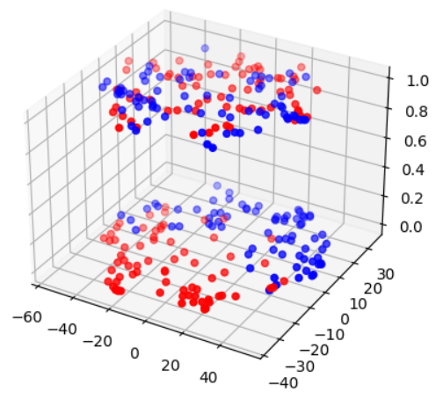
Project: Augmentation
An adaptive RBF kernel is equivalent to augmentation of one feature!
Extension:
Augment more representative features
Intuition:
Mean augmentation with EA: accuracy increase

Slide 14
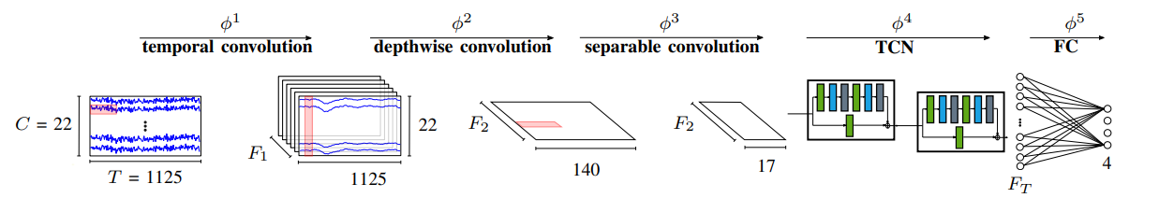
Project: Final Best Results
EEG-TCNet
Temporal-CNN
EA preprocessing: 1% extra accuracy (84% total)
Leave-one-subject-out cross-validation: Accuracy increase

Slide 15
03
Future Directions and Limitations
Challenges
Possible Directions

Slide 16
Challenges
Domain adaptation is difficult!
Many experiments failed (VAE, data augmentation, keeping transferable features etc.)
Avoiding negative transfer
Application to different datasets
Methods need to be robust
Data is hard to come by
Medical data
Online learning
Continual improvement

Slide 17
Possible Directions (This Project)
More features
cVAE
Neural networks
Adversarial training

